Slide 1



Be Prophet on Shared Mobility
Edgar Tomé
JUL, 8th | PARIS
DAFT MAY21

Slide 2


Business case
Domain
Utilizations of sharing mobility services, by provider, city and type of vehicles.
Data scrap from sharing mobility services providers.
Provide the combine information of position and number utilizations of sharing mobility services.
Problem
Missing data from the scrap process, during some periods of time.
Fill the missing data with values from time series model.
Find the best parameters to be used on model Prophet, to be more accurate with reality.
Experiment different parameters in different conditions for city and type of sharing .

Slide 3
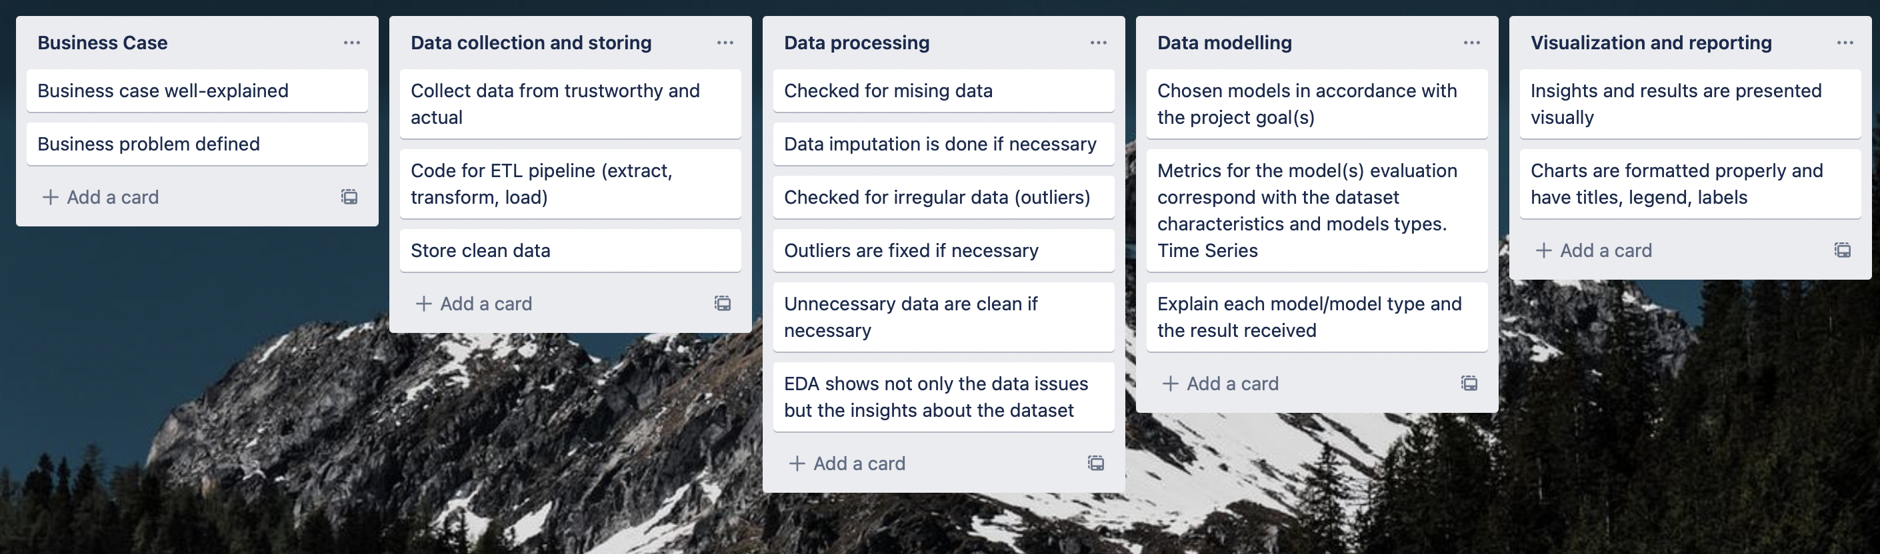

Plan
About data
Explore data provided by Fluctuo (Data provider for shared mobility ecosystem).
Analyse data and perform EDA.
Clean data if necessary.
Apply the model Prophet with default paraments.
Adjust model Prophet with different paraments, by hyperparameter tuning.
Apply model with adjusted paraments.
Compare results and tests.
Location of city
Type of sharing service
Provider
Time by day and hour
Weather (rain, snow, main)
Number of trips
Number of vehicle available

Slide 4
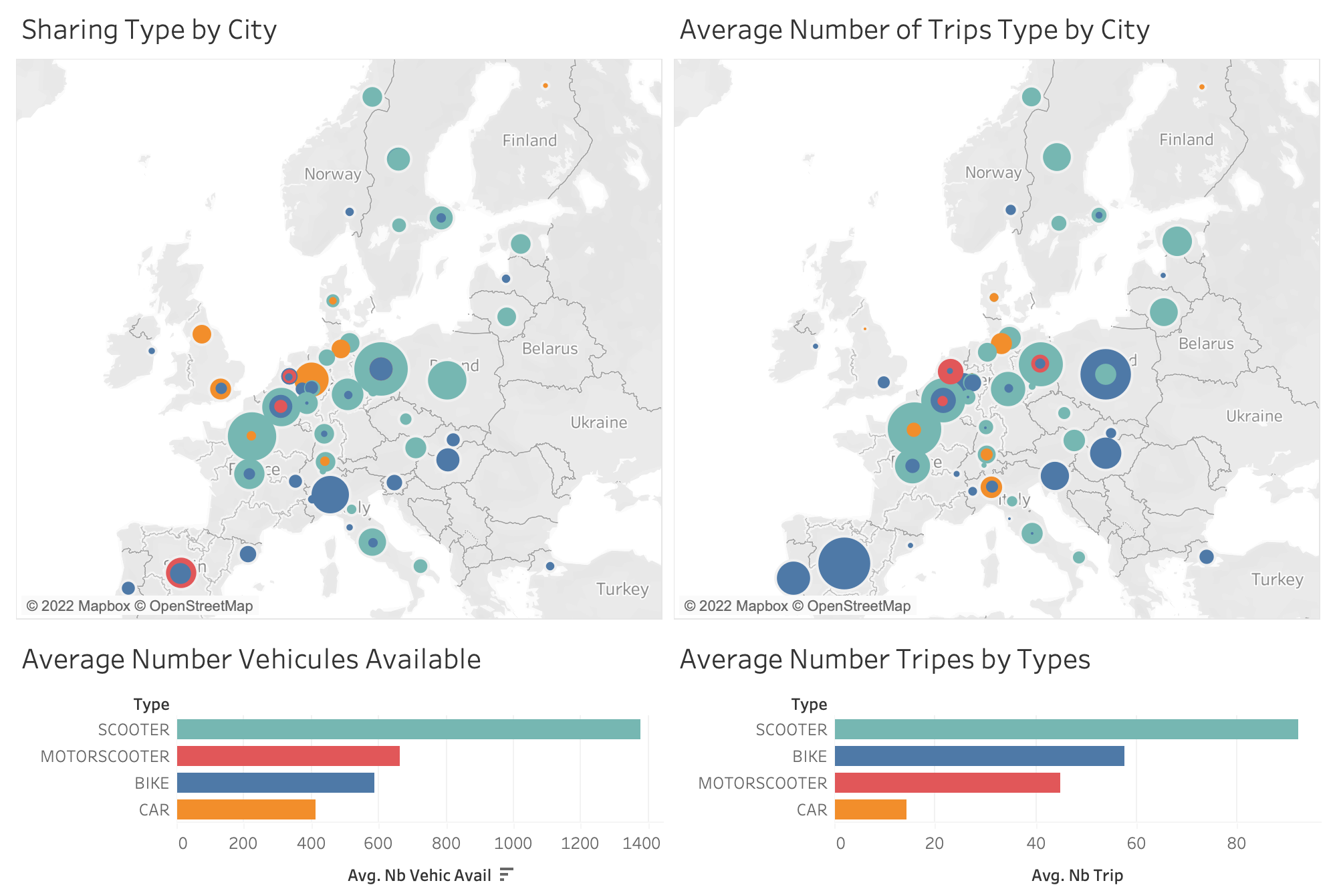
EDA
The type of sharing mobility services are different for every city.
As well the quantity of vehicles available

Slide 5
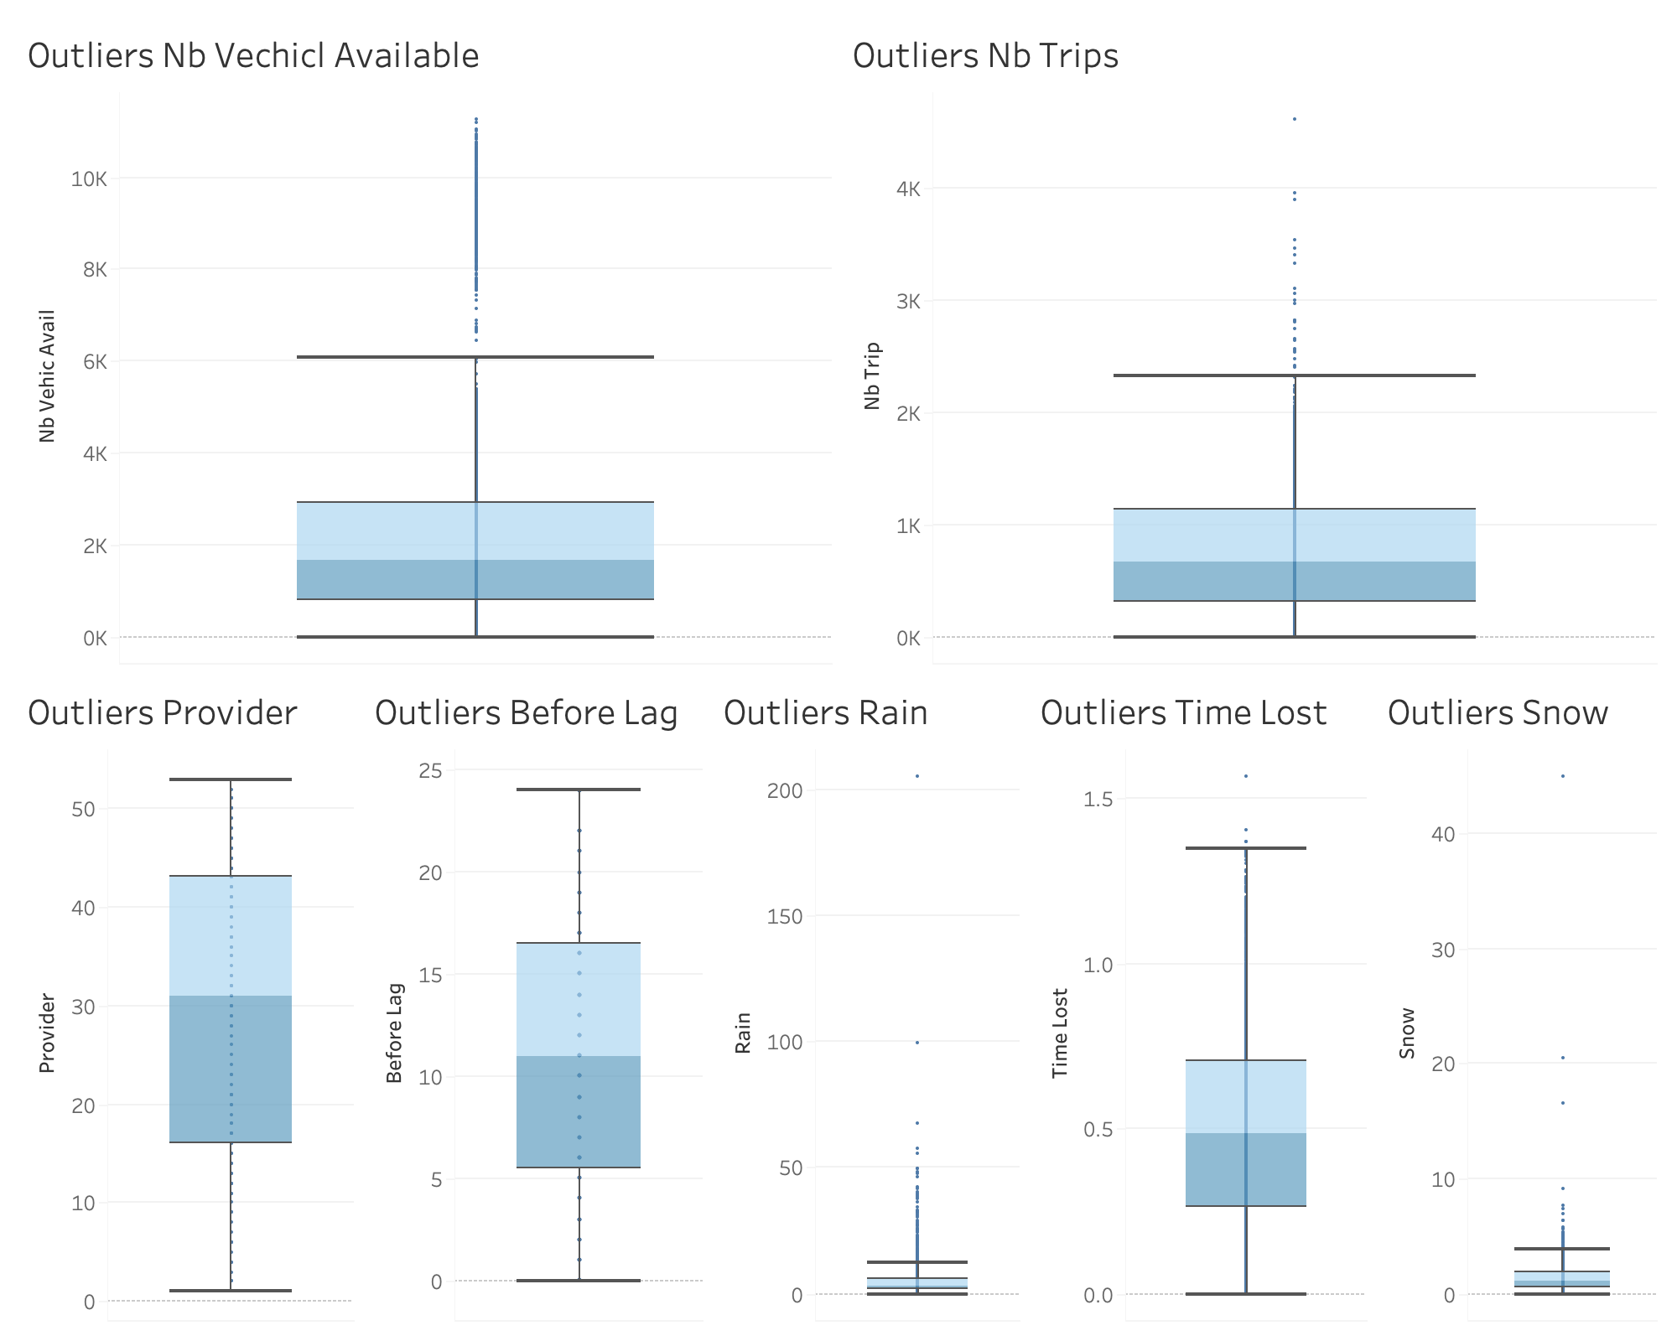
EDA
As observed on the distribution by city, there are cities that have bigger number of vehicles available, that others.
That's why we observed outliers on the data set.
For the application of the model, the data was separated, by city, provider and type of sharing mobility service

Slide 6
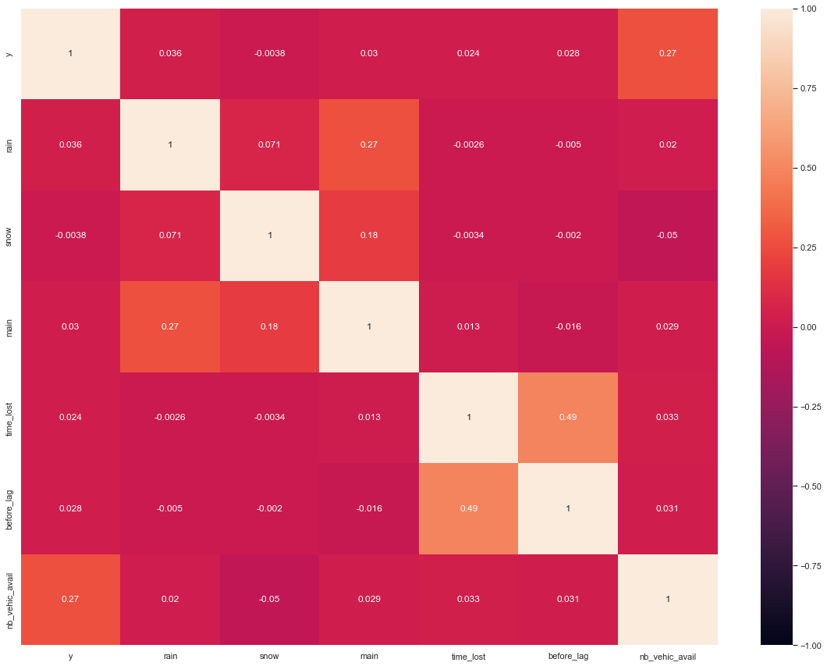
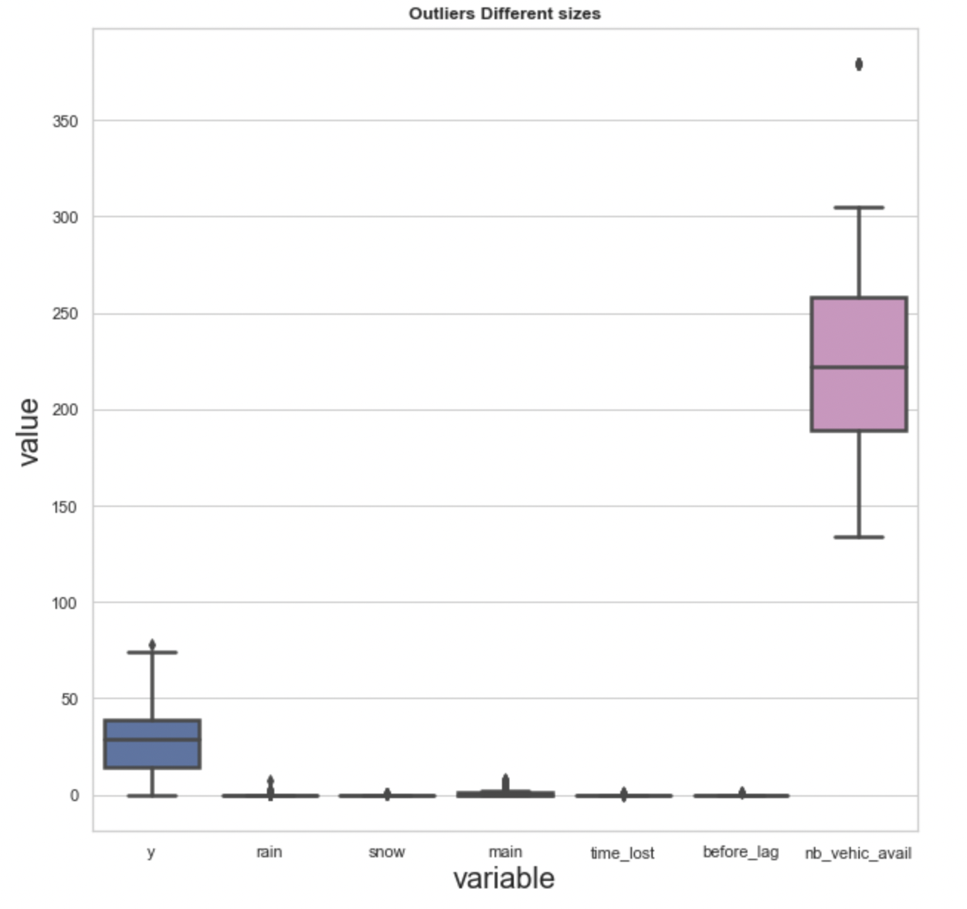
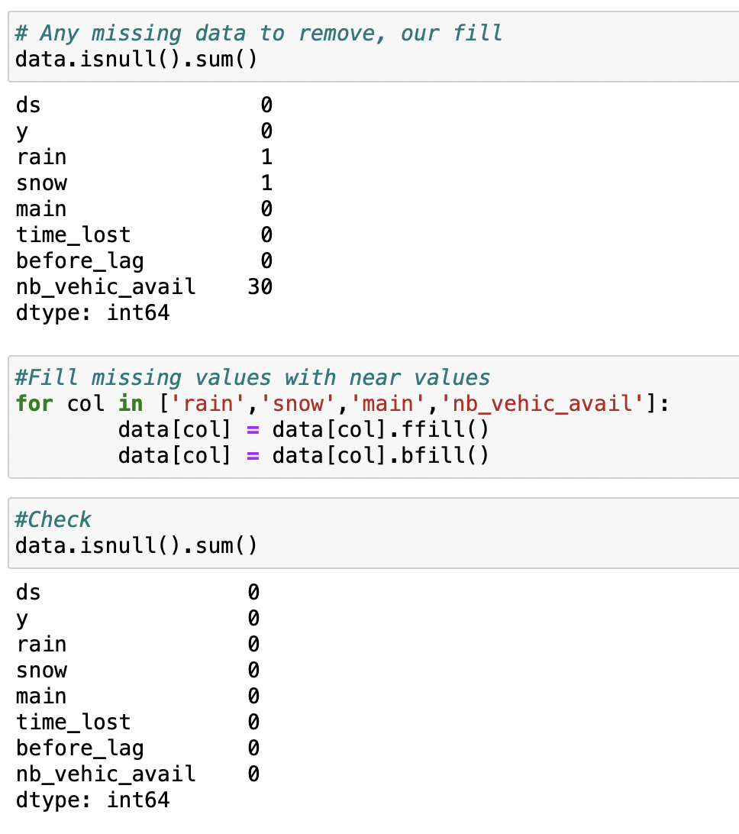
Data cleaning, data preparation
This process was done for all the six sub data sets.
Check missing values and fill with near by values.
Check for outliers.
Verification of correlation of data.
Transform the column of date that was in object to time type and remove time zones.

Slide 7
Model - Prophet
Prophet is optimized for the business forecast tasks, which typically have any of the following characteristics:
Hourly, daily, or weekly observations with at least a few months (preferably a year) of history;
Strong multiple “human-scale” seasonality day of week and time of year;
Important holidays that occur at irregular intervals that are known in advance;
A reasonable number of missing observations or large outliers;
Historical trend changes, for instance due to product launches or logging changes;
Trends that are non-linear growth curves, where a trend hits a natural limit or saturates;
The input to Prophet is always a data frame with two columns ds and y. Prophet follows the sklearn model API.
Notes:
The input to Prophet is always a data frame with two columns ds and y. The ds column should be of a format expected by Pandas, ideally YYYY-MM-DD for a date or YYYY-MM-DD HH:MM:SS for a timestamp. The y column must be numeric, and represents the measurement we wish to forecast.

Slide 8
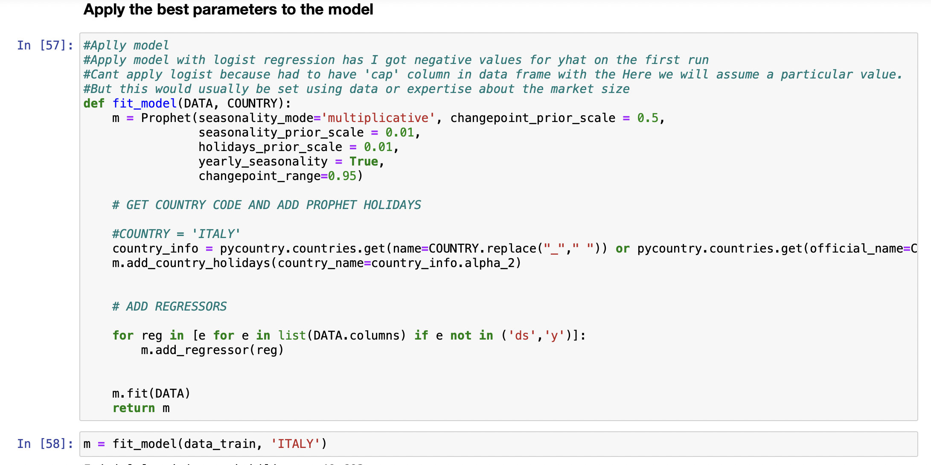
Model - Prophet
At its core, the Prophet procedure is a Bayesian time series with generalized additive regression model, with four main components:
A piecewise linear or logistic growth curve trend. Prophet automatically detects changes in trends by selecting changepoints from the data.
A yearly seasonal component modelled using Fourier series.
A weekly seasonal component using dummy variables.
A user-provided list of important holidays.
This factors are inserted on the model by stating the country where occurs the the event, and adding regressors factors regarding the weather.

Slide 9
Model - Prophet
Hyper Parameters study:
Changepoint prior scale: This is probably the most impactful parameter. It determines the flexibility of the trend, and in particular how much the trend changes at the trend changepoints. The default of 0.05.
Seasonality prior scale: This parameter controls the flexibility of the seasonality. Similarly, a large value allows the seasonality to fit large fluctuations, a small value shrinks the magnitude of the seasonality. The default is 10.
Holidays prior scale: This controls flexibility to fit holiday effects. Similar to seasonality prior scale. The default is 10.
Changepoint range: This is the proportion of the history in which the trend is allowed to change. It was used 95% of the history, meaning the model will not fit any trend changes in the last 5% of the time series. This is fairly conservative, to avoid overfitting to trend changes at the very end of the time series where there isn’t enough runway left to fit it well.

Slide 10
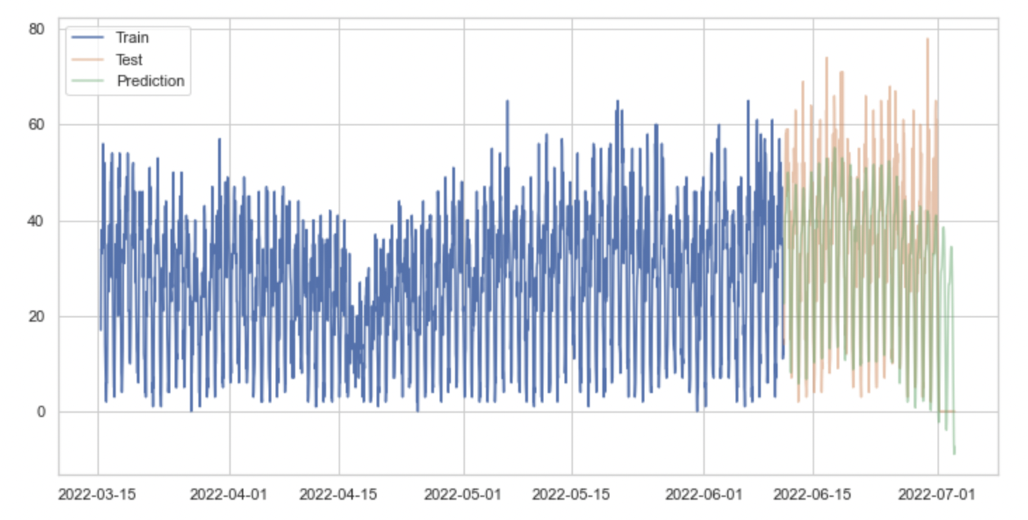
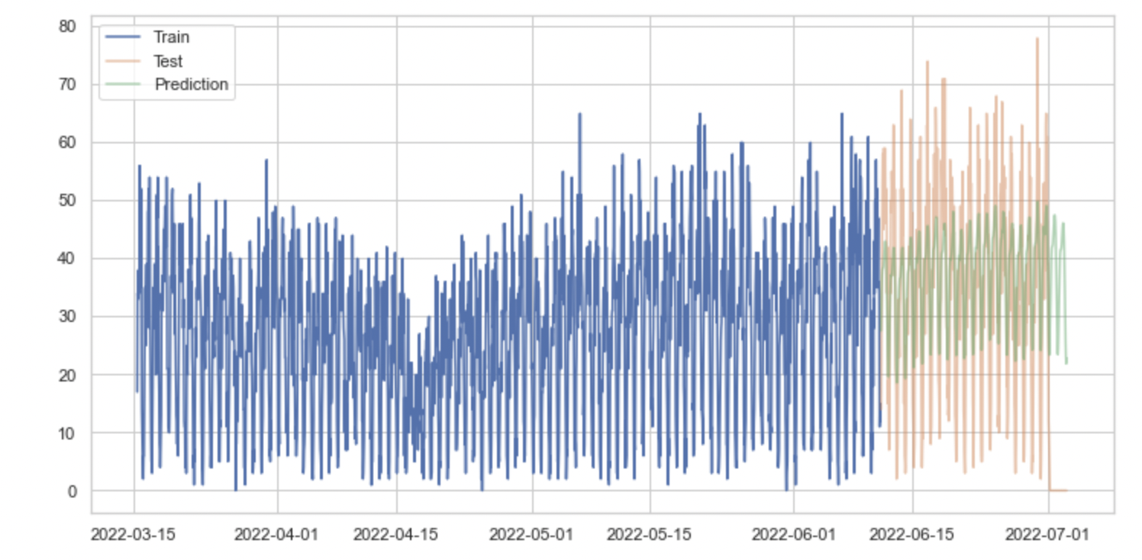
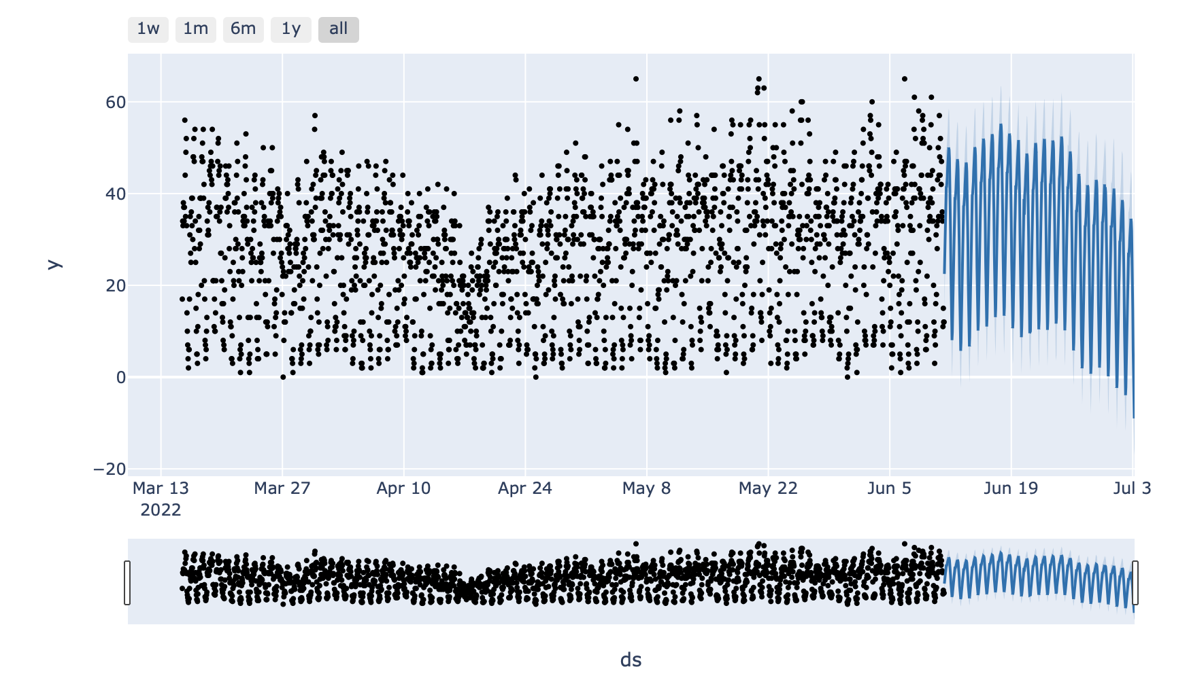
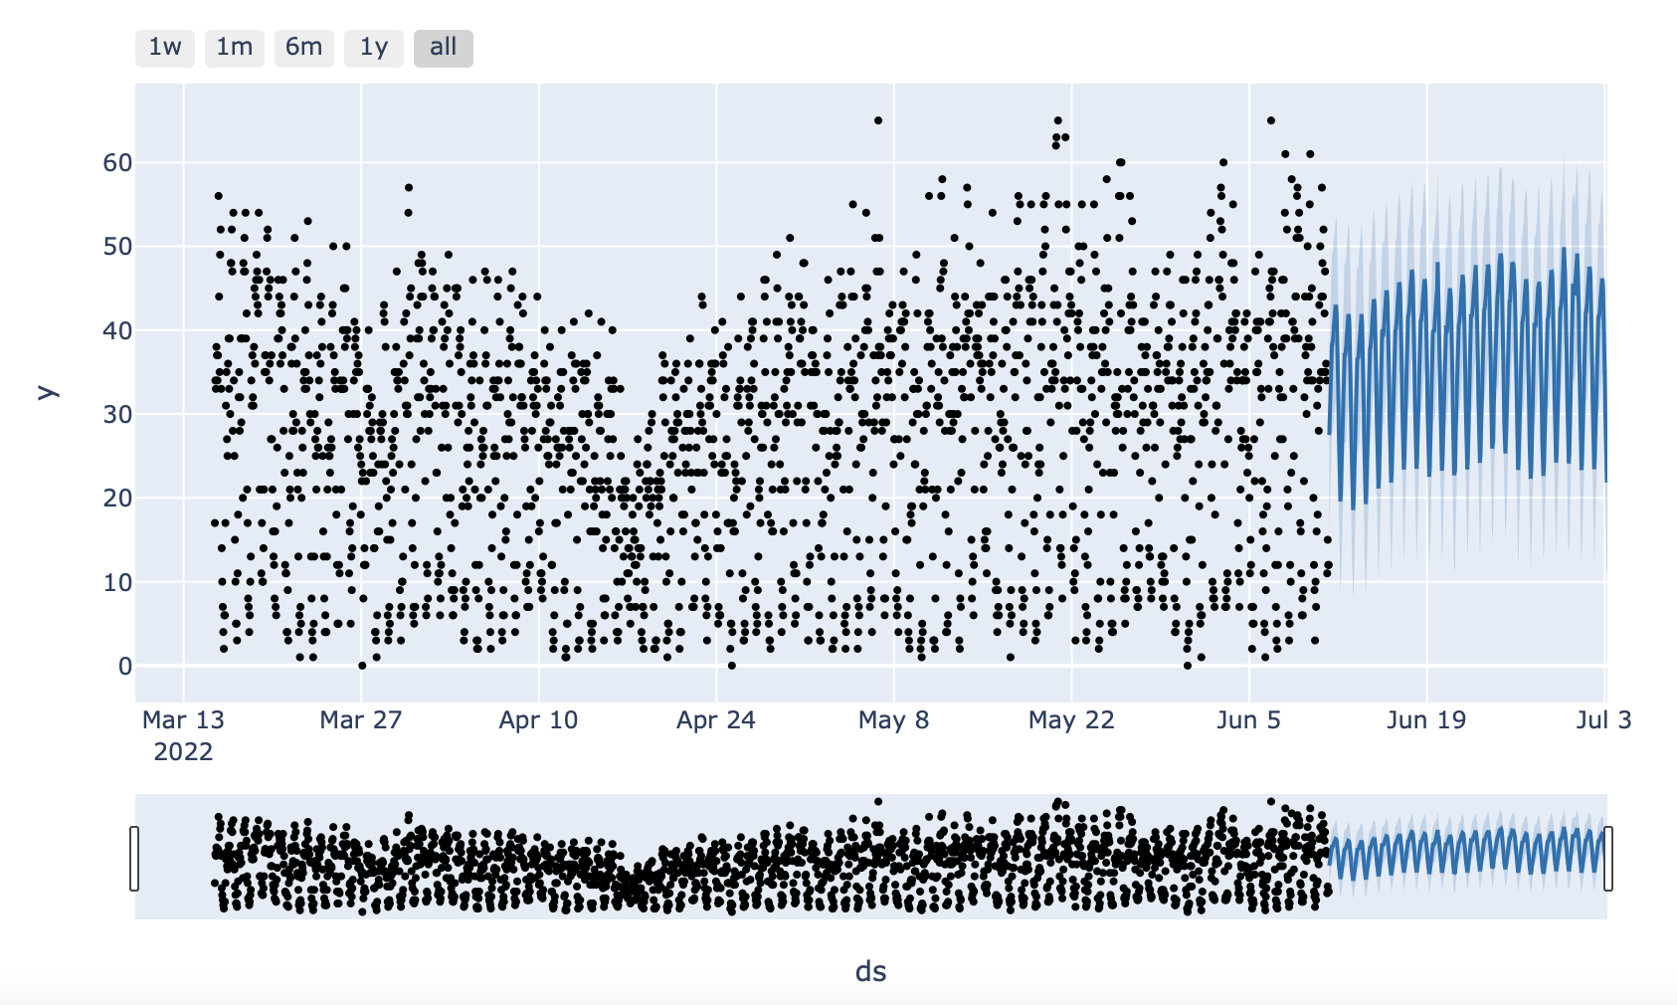
Model – Prophet – Paris - Car
Before Hyperparameter Tunning
After Hyperparameter Tunning

Slide 11
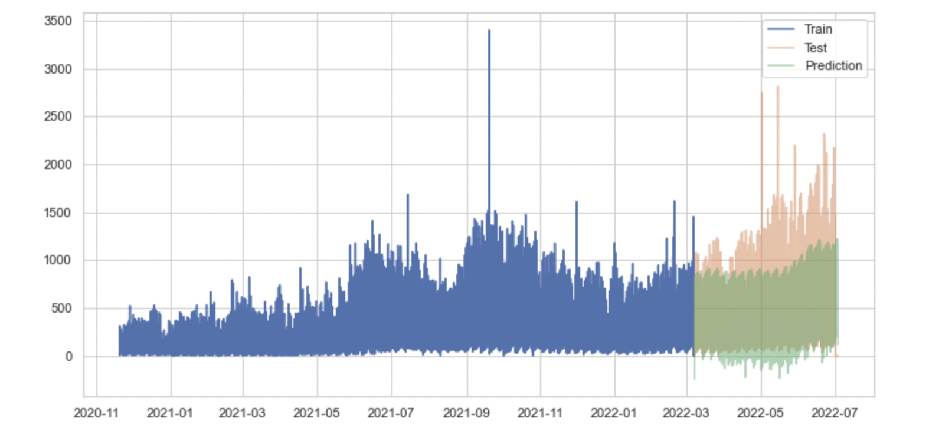
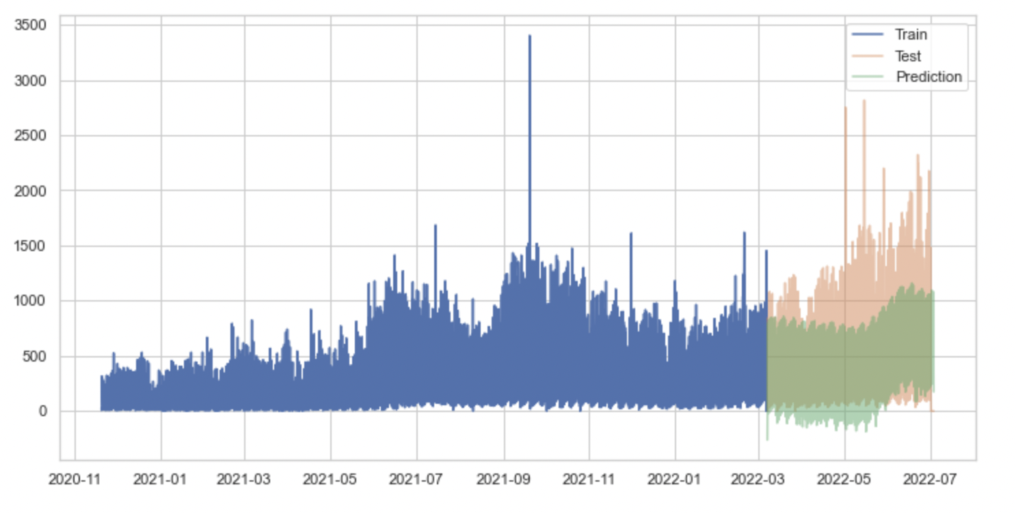
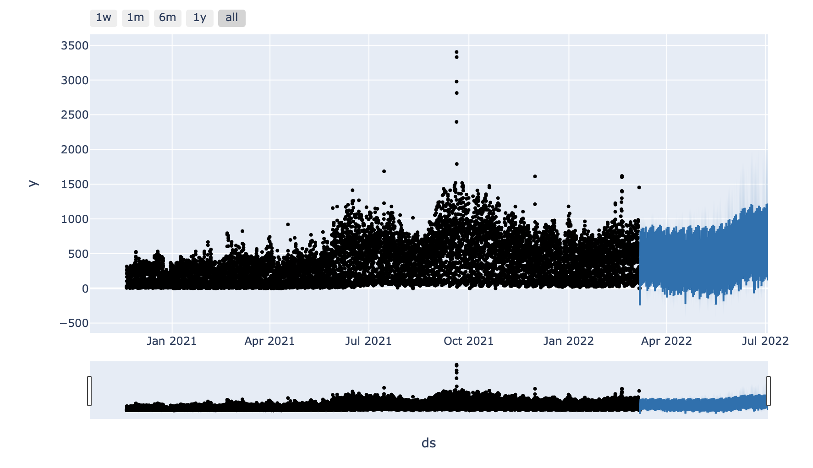
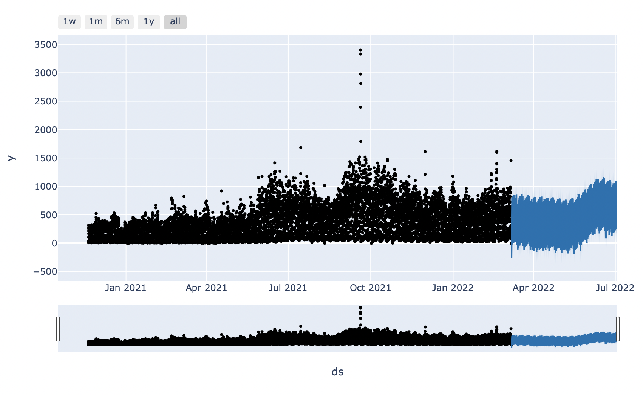
Model – Prophet – Paris - Scooter
Before Hyperparameter Tunning
After Hyperparameter Tunning
ters

Slide 12
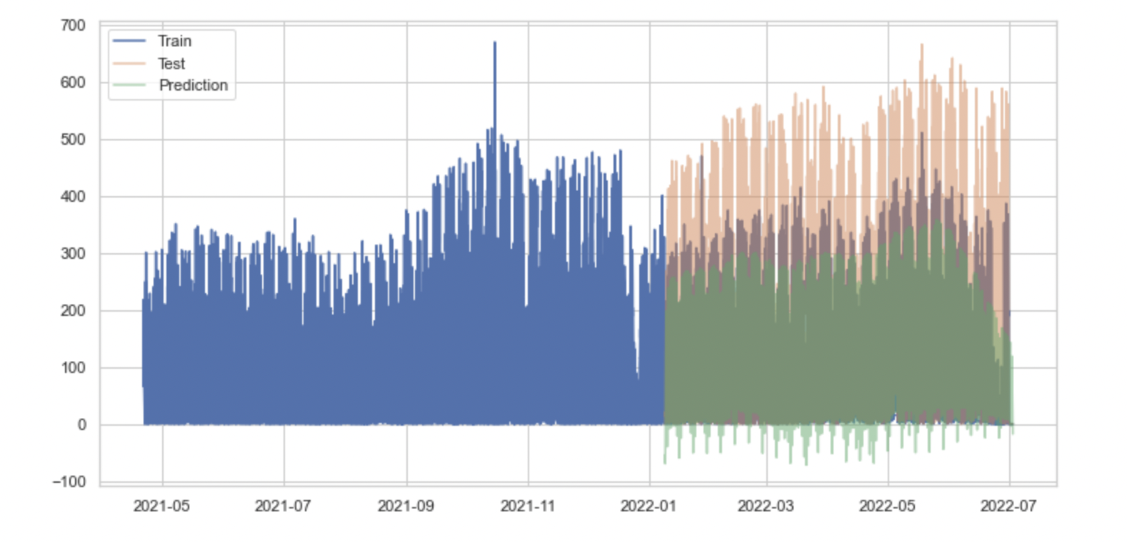
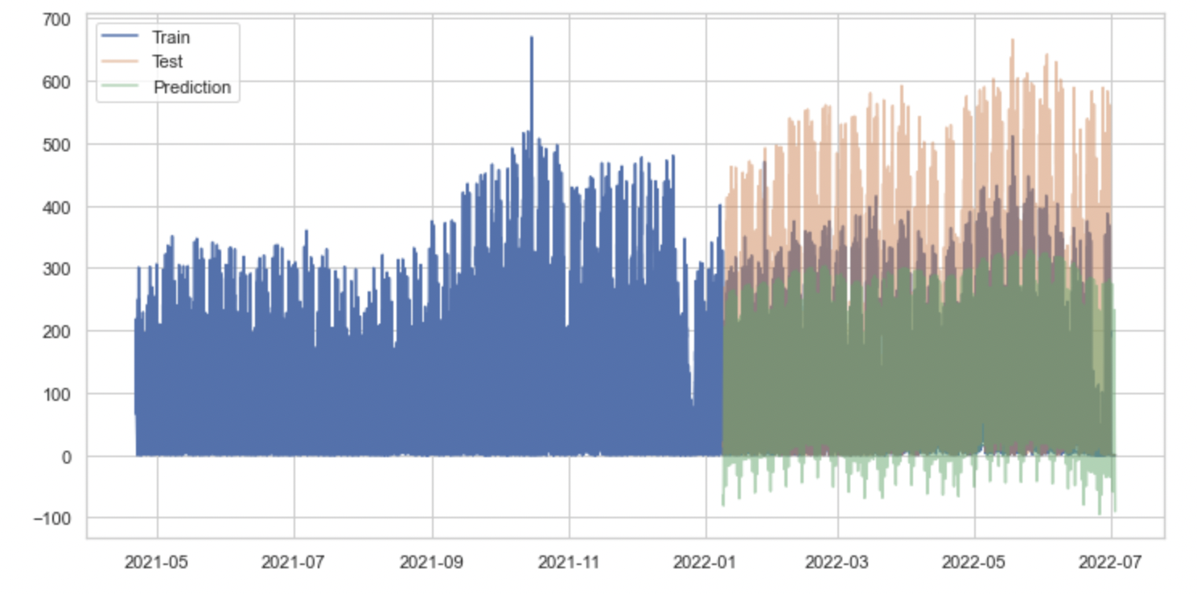
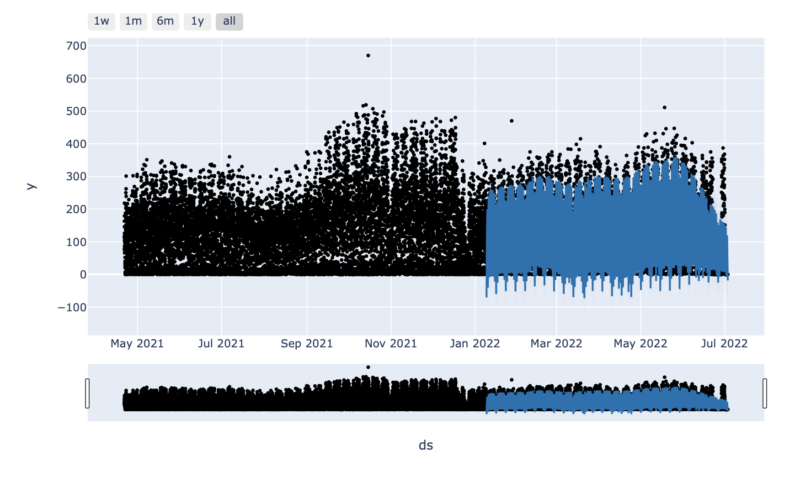
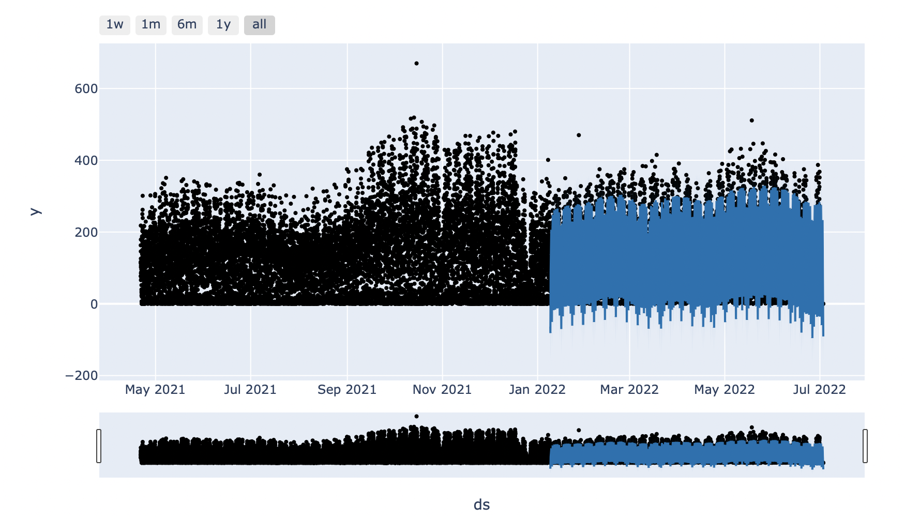
Model – Prophet – Lisbon - Bike
Before Hyperparameter Tunning
After Hyperparameter Tunning

Slide 13
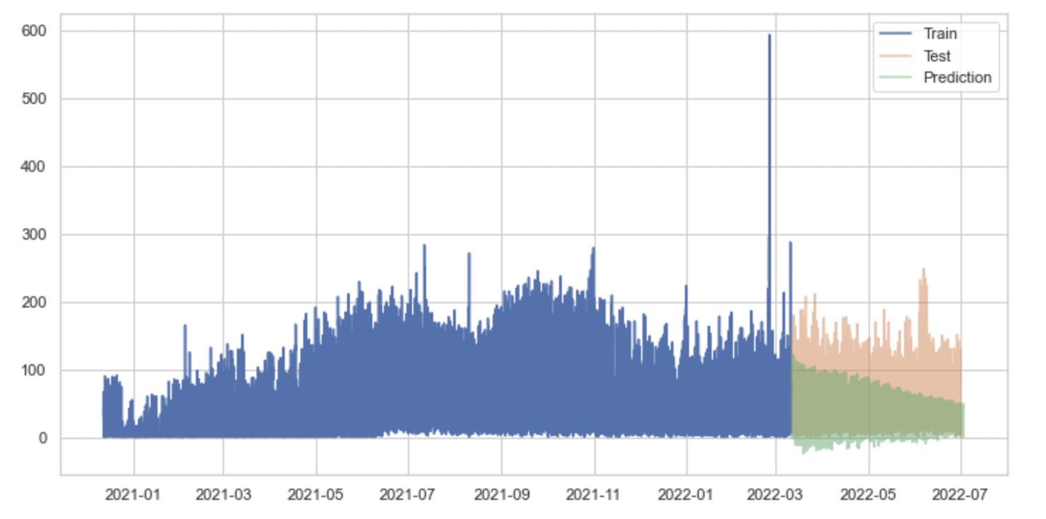
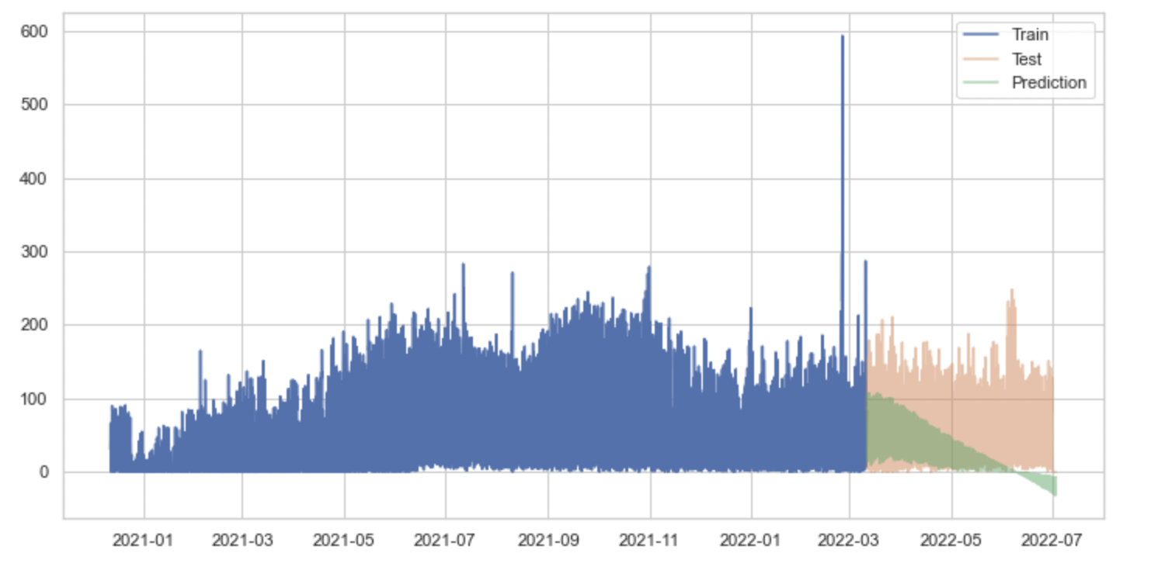
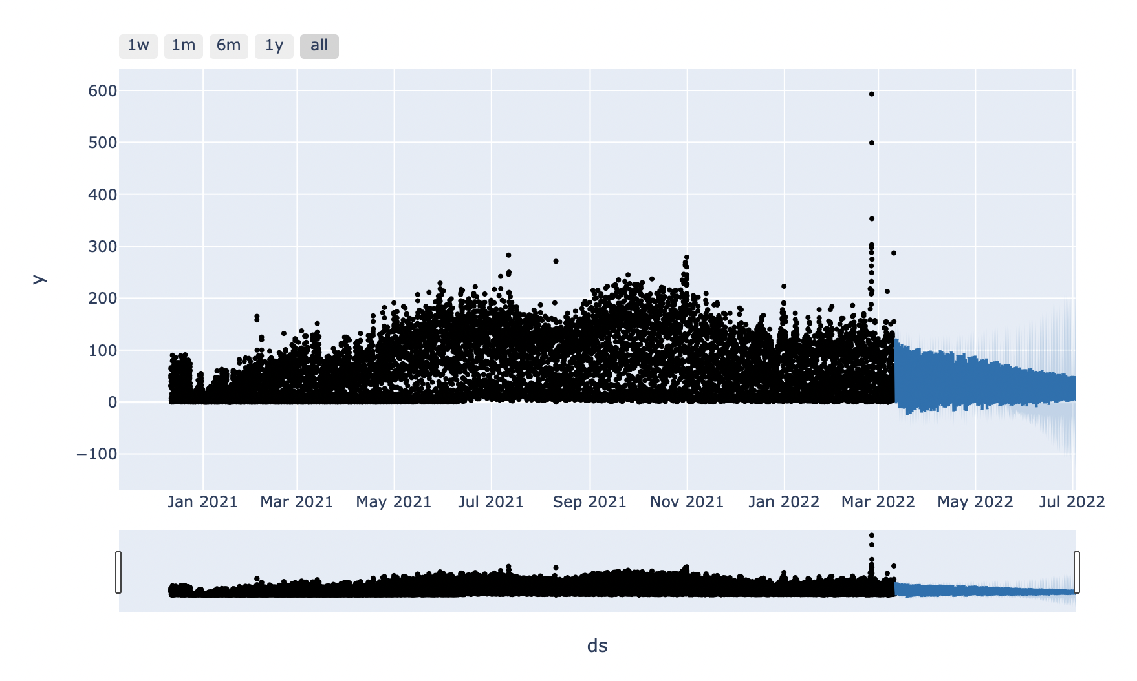
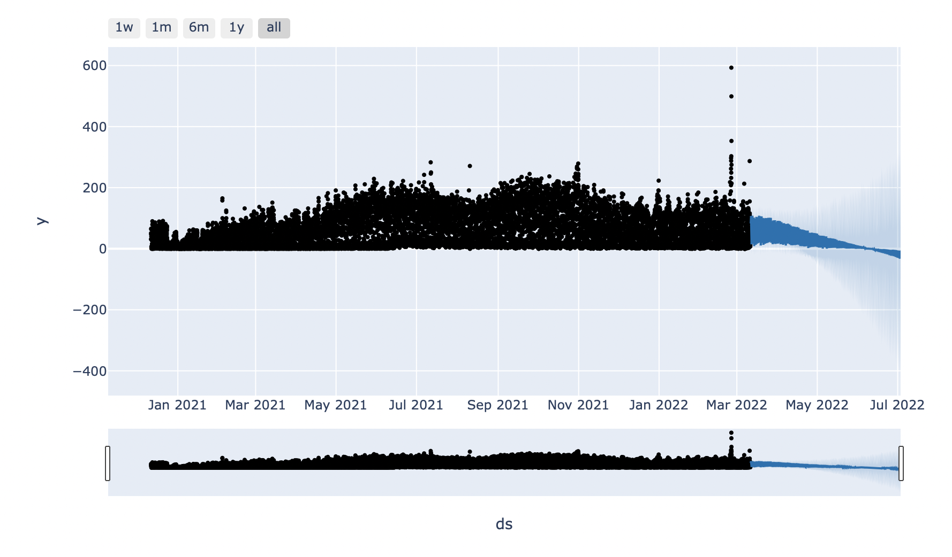
Model – Prophet – Rome - Scooter
Before Hyperparameter Tunning
After Hyperparameter Tunning

Slide 14
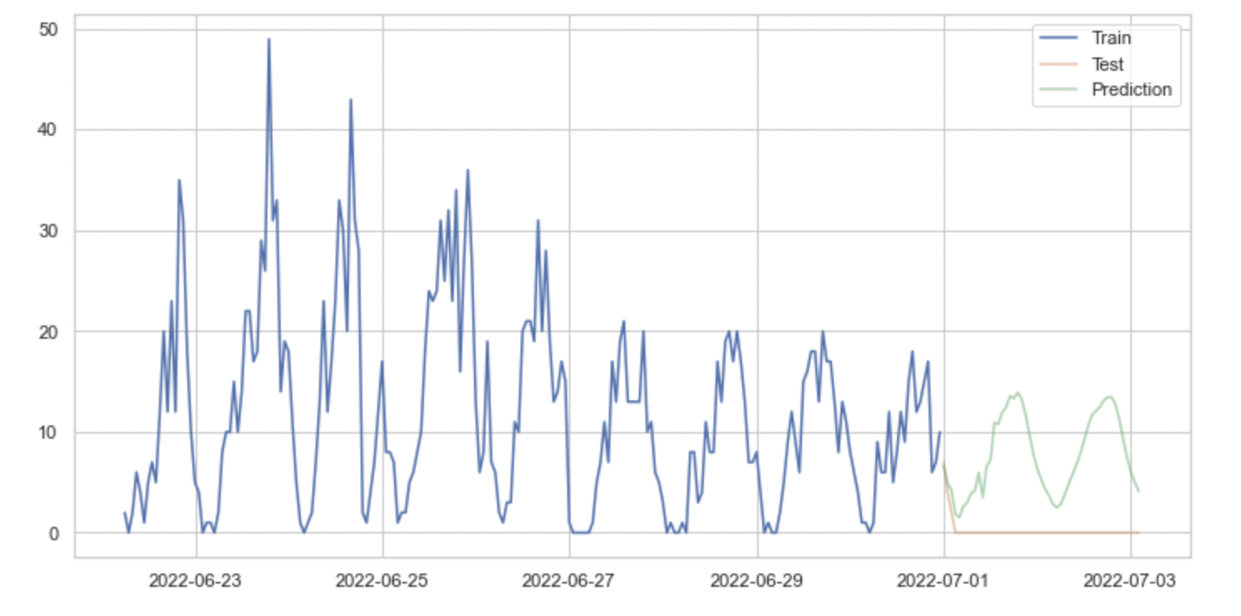
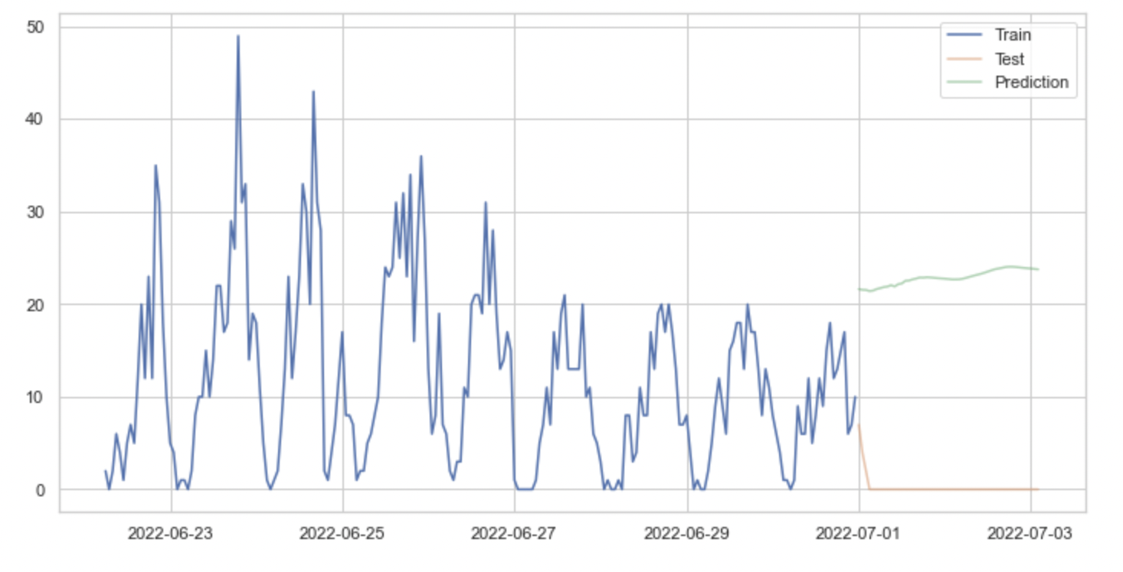
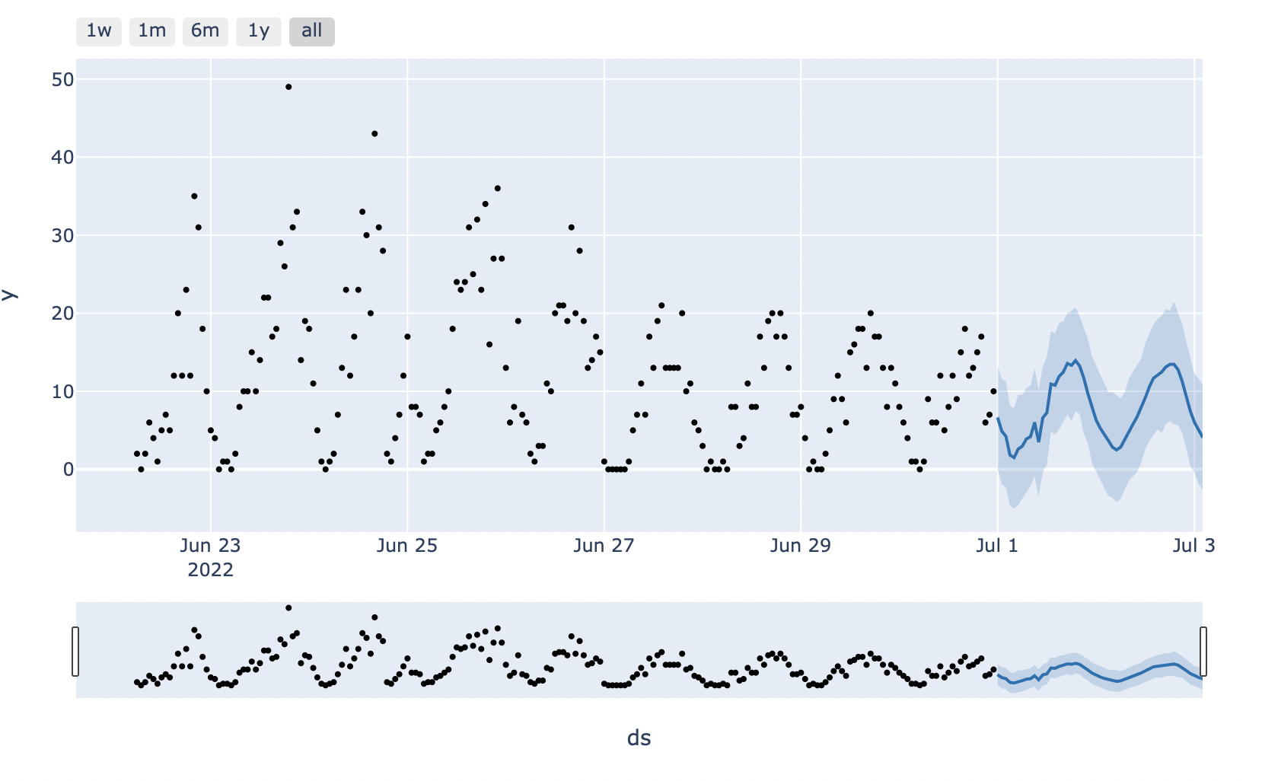
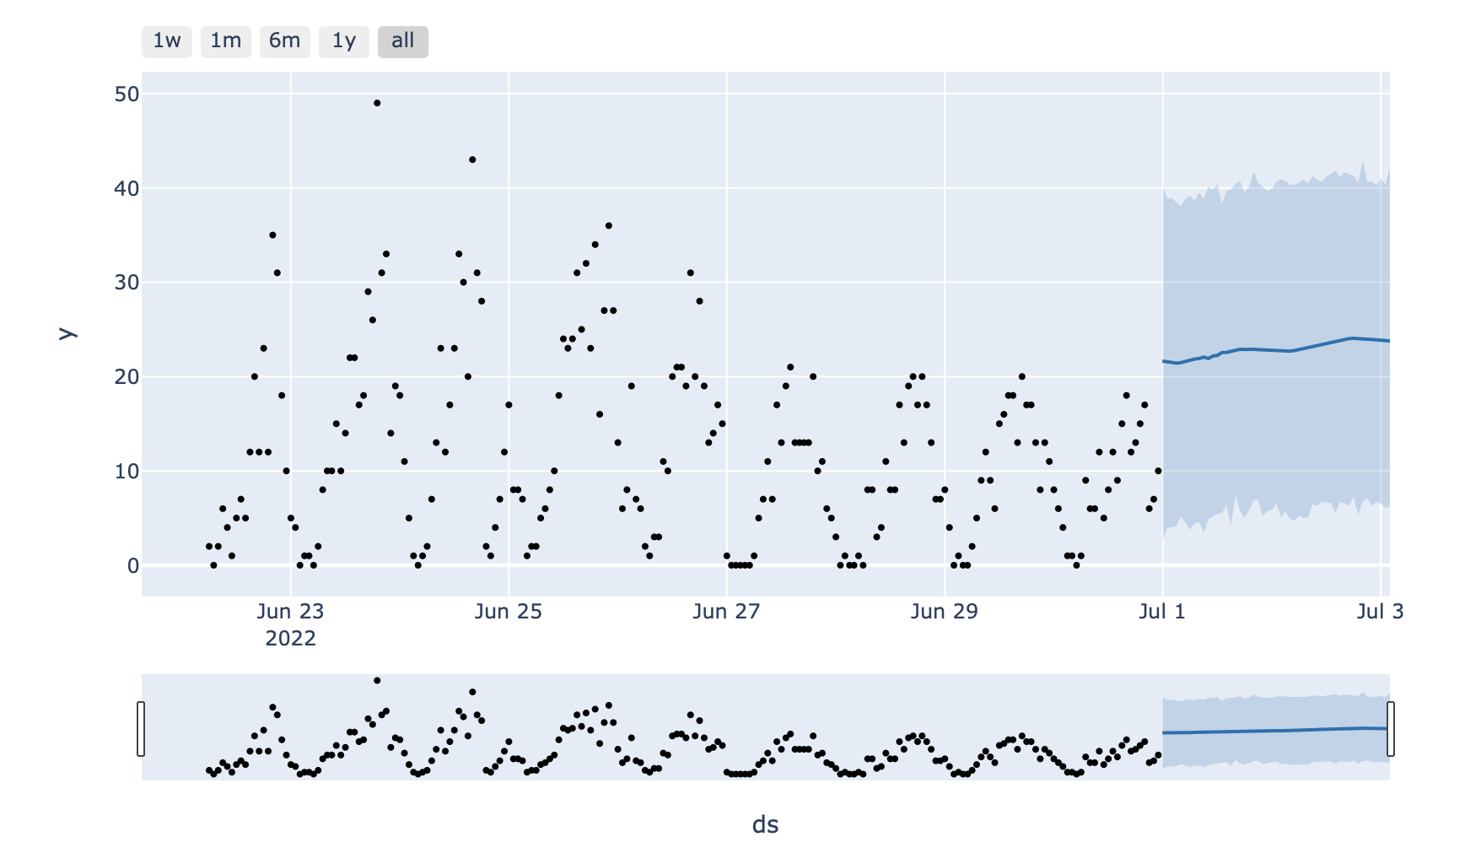
Model – Prophet – Frankfurt - Bike
Before Hyperparameter Tunning
After Hyperparameter Tunning
Notes:
Whit small data sets, hyper parameters flat the trend of event along time

Slide 15
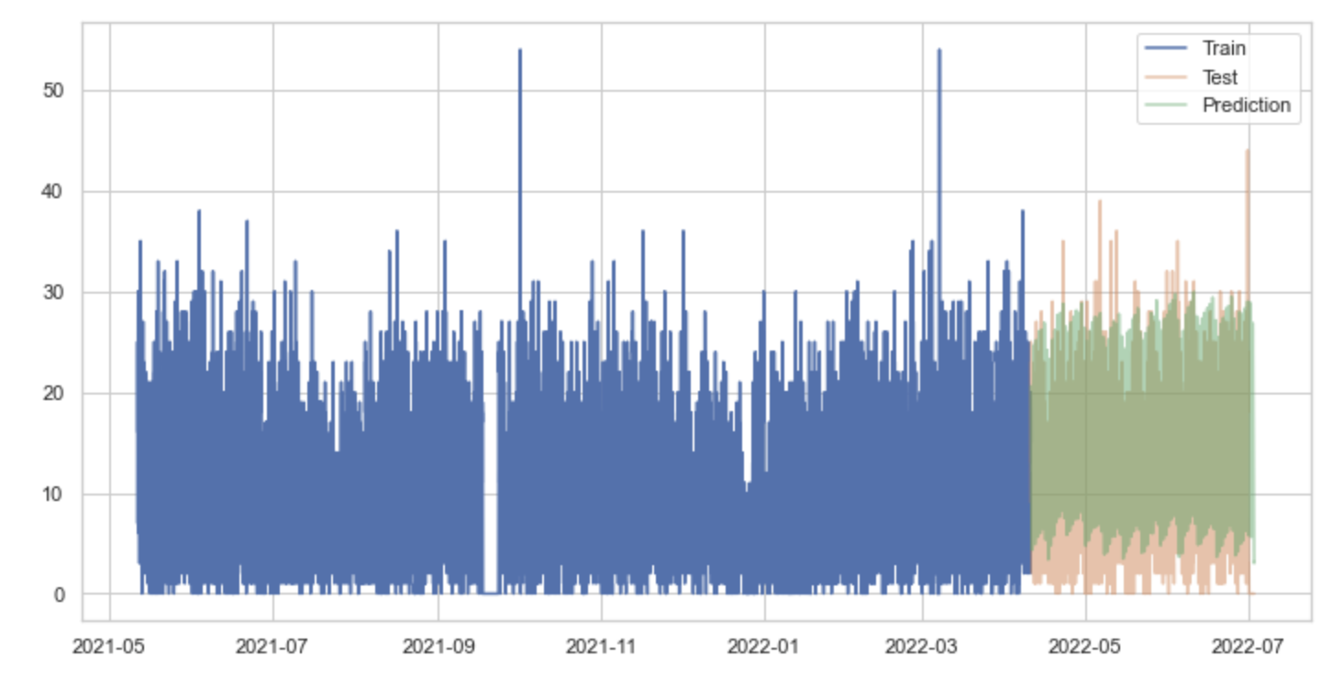
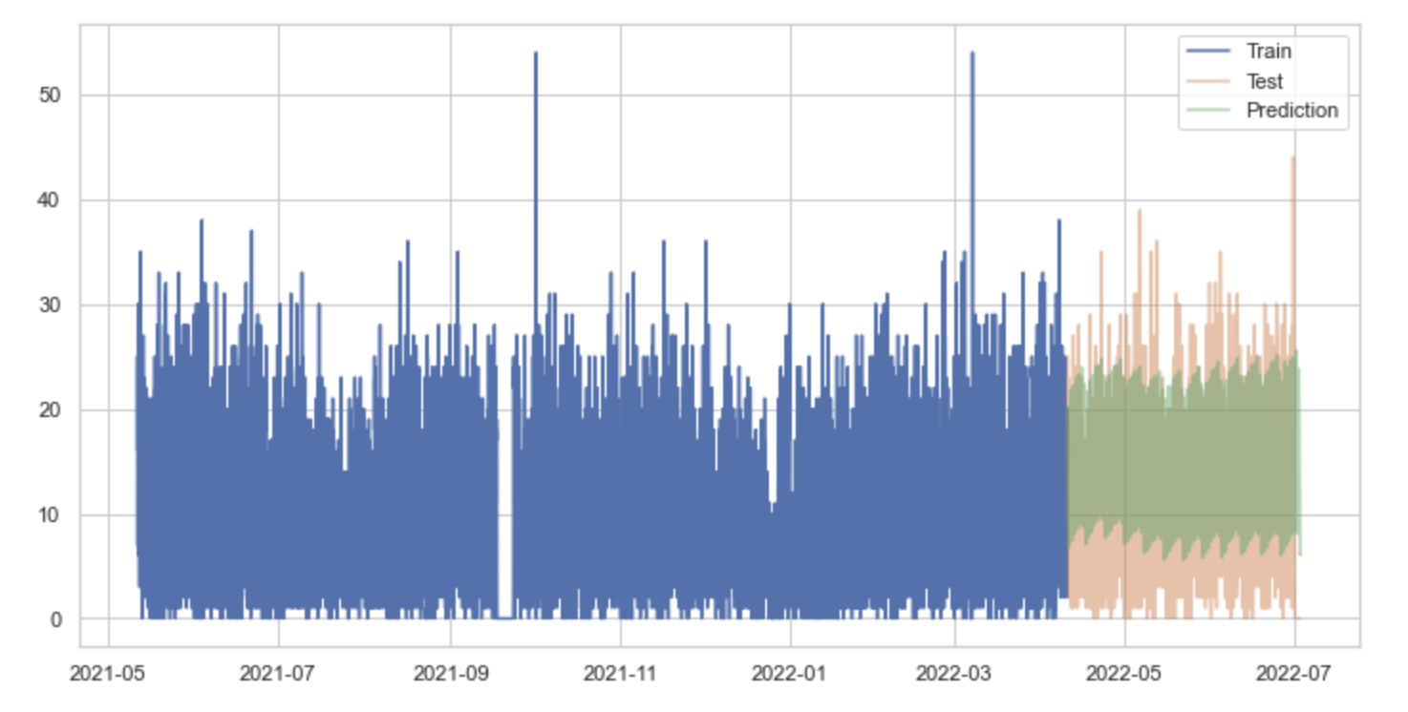
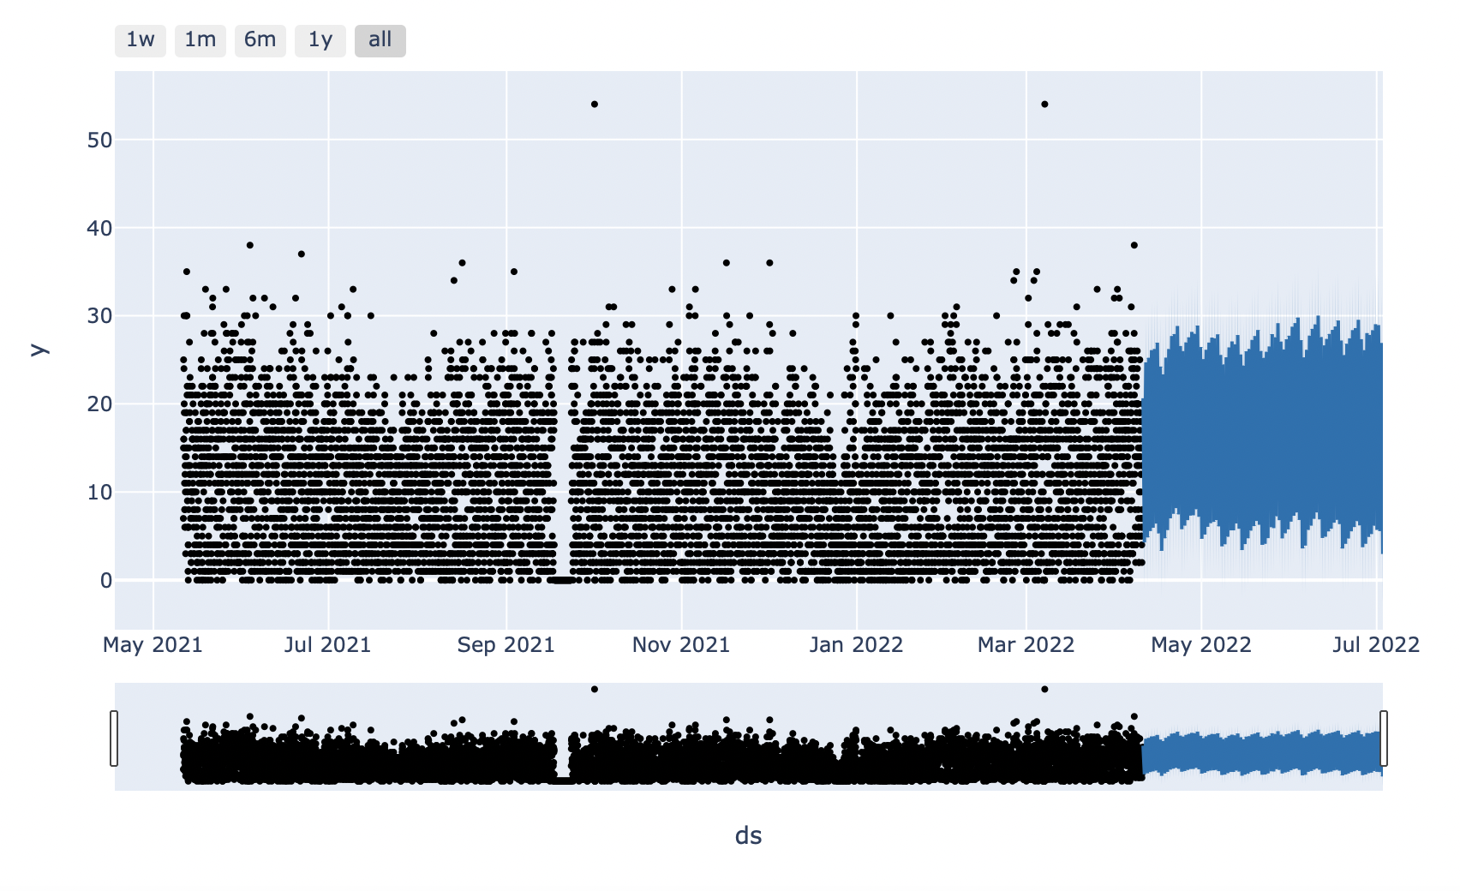
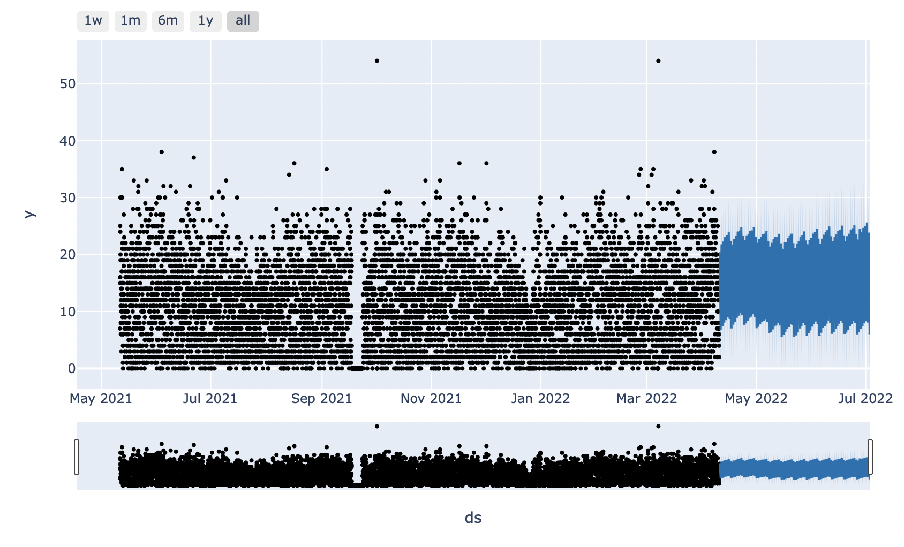
Model – Prophet – Aarhus - Car
Before Hyperparameter Tunning
After Hyperparameter Tunning

Slide 16
Model evaluation
City | Type sharing | Size Data (rows) | Days | RMSE with default hyper parameters | RMSE after hyper parameters tunning | Parameters
Paris | Car | 2635 | 109 | 11.44925 | 15.95570 | Changepoint prior scale: 0.001, seasonality prior scale: 0.01, holidays prior scale: 0.01 - Default Better
Aarhus | Car | 10027 | 417 | 6.53717 | 5.96210 | Changepoint prior scale: 0.1, seasonality prior scale: 0.01, holidays prior scale: 0.01 – Hyper Parameter Better
Paris | Scooter | 14166 | 826 | 314.94078 | 335.30091 | Changepoint prior scale: 0.001, seasonality prior scale: 1.0, holidays prior scale: 0.01 - Default Better
Frankfurt | Bike | 261 | 12 | 8.56071 | 22.68750 | Changepoint prior scale: 0.001, seasonality prior scale: 0.1, holidays prior scale: 0.01 – Default Better
Rome | Scooter | 13647 | 682 | 44.15615 | 64.54020 | Changepoint prior scale: 0.5, seasonality prior scale: 0.01, holidays prior scale : 0.01 – Default Better
Lisbon | Bike | 21012 | 437 | 119.32641 | 117.17939 | Changepoint prior scale: 0.001, seasonality prior scale: 0.1, holidays prior scale: 0.01 – Hyper Parameter Better
Notes:
root mean square error, which is a metric that tells us the average distance between the predicted values from the model and the actual values in the dataset.
The lower the RMSE, the better a given model is able to “fit” a dataset.

Slide 17
Main results - Conclusions
The model profhet is a good model to be emplace in business forecast tasks, where the trend depends of the frequency of the event along the time.
The location where occurs the the event, and is particularities characteristics that can affect the trend, are taken in consideration by the model, like the holidays and the weather.
The model works better with data that register the event along at least one year, but even for small data sets, can be very occurs for the sort time that as to predict the event.
For the study of hyper parameters of the model of the data set in study I will recommend apply the parameter holidays prior scale with the value of 0.01, and the rest by default, because they can change depending of the quantity of the data provide to the model.

Slide 18

Be Prophet on Shared Mobility
Questions?
Edgar, Tomé

